Slide 1
KISSAN JAM
Somu

Slide 2
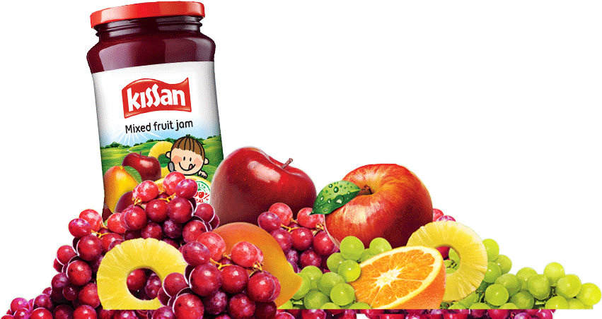
STP
Segment | People wanting to have a sweet breakfast
Target Group | All people in the upper and middle class
Positioning | Makes food interesting

Slide 3
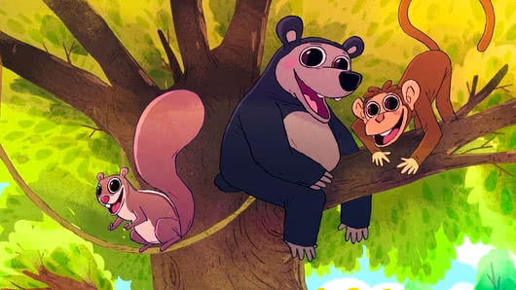
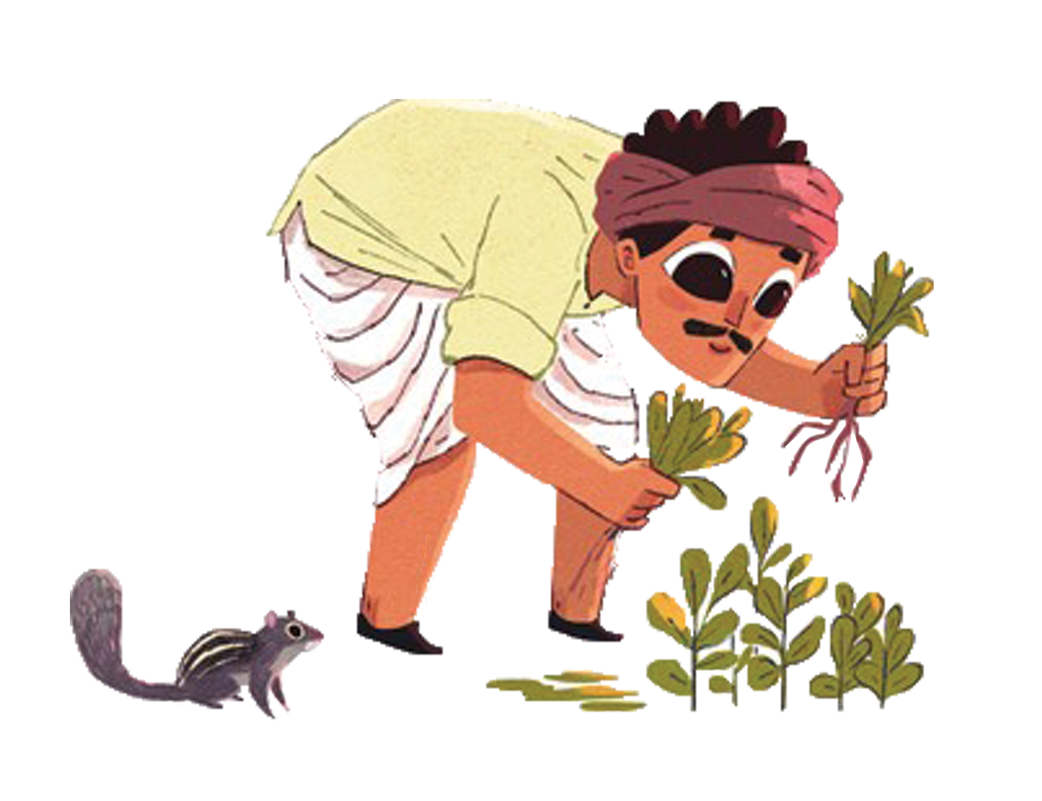
Before Advertisement
Age group below 10 average sales is 17846.
Age group between 11 and 20 average sales is 25937.
The above averages are taken before the 8 mix jam cartoon Ad

Slide 4
Before Advertisement

Slide 5

TARGET
Promotional schemes and offers specially for kids who are the main target customers by the company.
Interacted with targets in parenting & motherhood, women, men, bargain shopping and marketing and advertising communities.
Kissan also innovated in packaging. This was good enough to attract children. With competitors like Lion, this brand attracts children and provides them with a better, healthy and tastier food product.

Slide 6
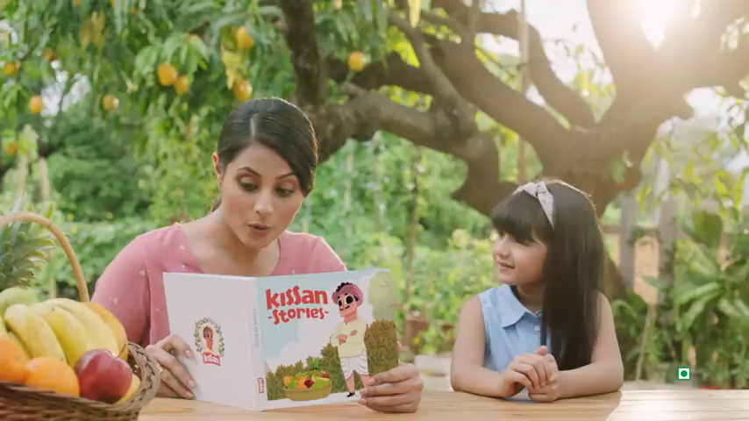
8 Mix Fruits Cartoon Ad

Slide 7
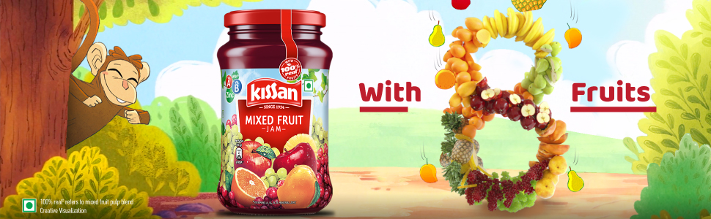
After Advertisement
Age group below 10 average sales is 26206.
Age group between 11 and 20 average sales is 26367.
The Above averages are taken after the 8 mix jam cartoon Ad

Slide 8
After Advertisement

Slide 9
Hypothesis comparison
Before Ad
After Ad
P value : 0.4525
Null Rejected
Null Accepted
Sales are different
Sales are equal
P value : 0.00002
Two sample T-test
Two sample T-test
Alpha = 0.05
Alpha = 0.05

Slide 10
SWOT ANALYSIS
Strength | Strong brand name Excellent advertising and visibility Good product distribution and availability Lots of flavours and varieties available
Weakness | Food products have a limited self life
Opportunity | Tie–ups with corporates Cheaper packets for rural areas
Threats | Health conscious people avoiding sweets

Slide 11

Conclusion
• There is a great difference in sales before 8 mix cartoon advertisement.
• After the release of the Ad, the sales are almost equal.
• Because of the targets they fixed, this was achieved.
• Kissan jam customers are highly loyal towards the product.

Slide 12


